Slide 1
World War II Timeline Project
Skye Yang
U.S. History Mr. Tucker
3/8/2024

Slide 2
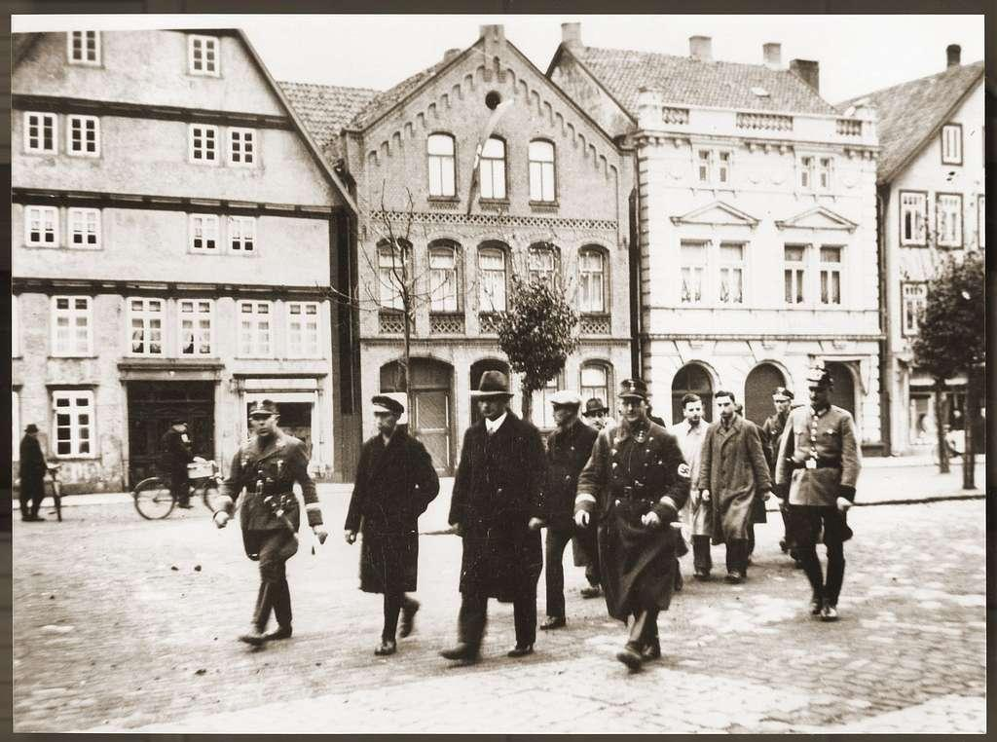
Kristallnacht
In Nov. 1938, Hitler ordered Joseph Goebel, the prime minister of propaganda to stage attacks on Jews around Germany. Kristallnacht started on Nov. 9, where many Jews were attacked and their properties were destroyed by Nazi agents disguised as normal citizens. People and the police were forbidden to stop them. This change the German public to be opposed to Jews causing Jewish Germans to flee from Germany. Most Jews however couldn’t escape the Nazis for long.
Notes:
Image obtained from Google Images and is licensed for reuse.
Tucker, Ryan. Lecture given at Clovis High School. February 2024.
United States History & Geography Community & Change
Jews rounded up in Stadthagen after Kristallnacht 2 (Public Domain), Picryl.

Slide 3
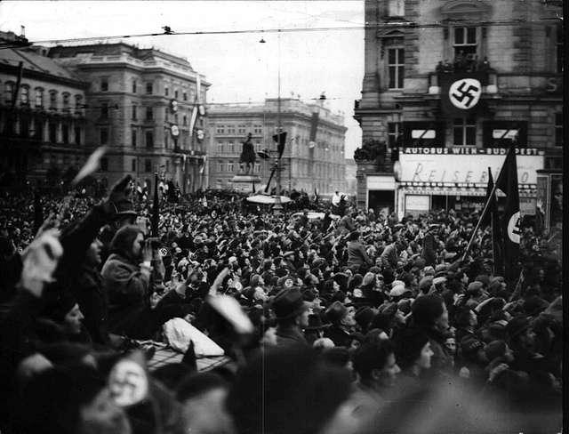
Anschluss
In 1935, Hitler was now the leader of Germany and he set his eyes on other nations beginning to defy the Treaty of Versailles created after World War 1. In 1938, Hitler started to expand his power first invading Austria, he felt Austria belonged to Germany because German people where living there. He had a successful invasion on Austria declaring it Anschluss. Anschluss is a unification of Austria and Germany and Hitler continue to target on nations that he saw as apart of Germany which caused conflict on Europe.
Notes:
Image obtained from Google Images and is licensed for reuse.
Tucker, Ryan. Lecture given at Clovis High School. February 2024.
United States History & Geography Community & Change
Schwarzenbergplatz Durante Al Anschluss 193803 - A black and white photo of a crowd of people (Public Domain), Picryl

Slide 4
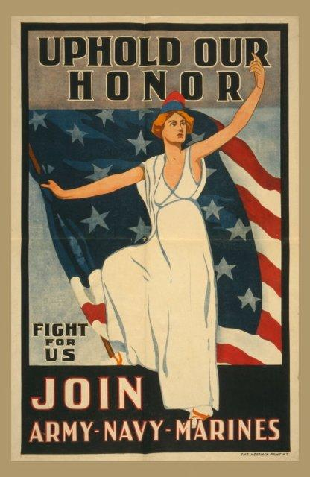
Selective Service Act
World War 2 began on Europe in 1939 and Germany had the upper hand on Great Britain and France. The FDR was re-elected to be president of United States in 1940, he wanted to stop Germany and wanted America to no longer be isolated from the world. He and Congress started to built for the defense United States, if they have to enter the war. The Selective Service Act was passed which required Americans to have military experience if war happened. People served for 1 year and only in the Western Hemisphere, this prepared American for the oncoming war in a few years.
Notes:
Image obtained from Google Images and is licensed for reuse.
Tucker, Ryan. Lecture given at Clovis High School. February 2024.
United States History & Geography Community & Change

Slide 5
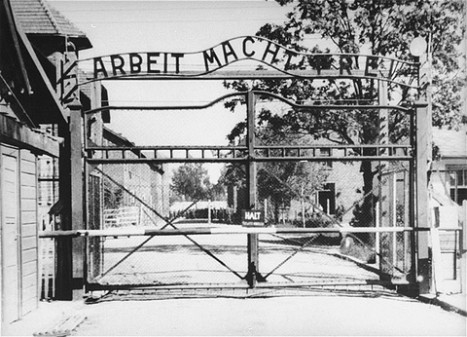
Auschwitz Camp
Auschwitz was a German Nazi extermination camp that was created by the Final Solution in 1942. Auschwitz hold many Jews and hated discriminate groups, these people couldn’t work on the concentration camps so they were put in Auschwitz to die. People were trapped in barracks and were usually killed in gas chambers over 10,000 people were killed per day. This camp single handedly killed millions which included Jews, Poles, Roma, and Soviet POWS.
Notes:
Image obtained from Google Images and is licensed for reuse.
Tucker, Ryan. Lecture given at Clovis High School. February 2024.
United States History & Geography Community & Change
Auschwitz gate in 1945 (Public Domain), Picryl

Slide 6
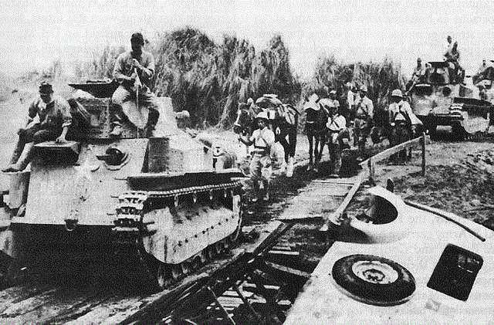
The Fall of The Philippines
In December 1941, right after they bombed Pearl Harbor, Japan attacked the Philippines to destroy American airfields. The Japanese Empire had an huge army of land troops to attack the forces in the Philippines. General Douglas MacArthur was defeating the airfields with American and Filipino troops but this was a losing battle. On April 9, 1942, MacArthur was ordered to evacuate the Philippines leaving American and Filipino defenders to surrendered. These people were forced to march to Japanese prison camps. This was a major lose for the United States, they have lost land and naval power.
Notes:
Image obtained from Google Images and is licensed for reuse.
Tucker, Ryan. Lecture given at Clovis High School. February 2024.
United States History & Geography Community & Change
Philippine Islands Jap tanks full (Public Domain), Picryl

Slide 7
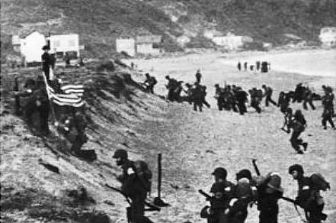
North Africa Campaign
During 1942, War World 2 was at its middle of it’s conflict and America before joining the war, had made plans to get into Europe quickly but they were in a dangerous two front war. Prime Minister Churchill believed America and the Allies was not ready to dive right in to Europe and lead a plan to invade the peripheries of the German Nazis. This lead to the invasion of North Africa or Operation Torch where General Dwight D. Eisenhower lead the Allies against German forces in North Africa commanded by General Erwin Rommel. This invasion lasted till May 13, 1943, where the Allies pushed the Nazis back leading the last German troops to surrender. This campaign was an Allied victory, Allied leaders decided to only accept unconditional surrender from Axis nations.
Notes:
Image obtained from Google Images and is licensed for reuse.
Tucker, Ryan. Lecture given at Clovis High School. February 2024.
United States History & Geography Community & Change
Allied invasion into Algeria during Operation Torch (Public Domain), Picryl

Slide 8
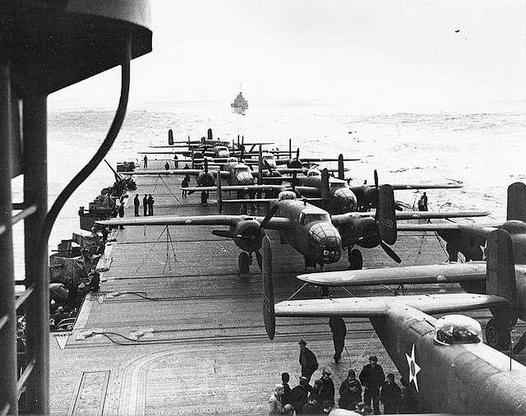
The Doolittle Raid
In 1942, America knew for sure that their war with Japan on the Pacific depended on their navies. America wanted to bomb Tokyo to raise the morale of the American people but they needed aircraft carriers to be close and Japanese naval forces where around the North Pacific. A plan was established that B-25 bombers with their long range firepower to bomb Tokyo. This raid was lead by James Doolittle, a lieutenant colonel, where sixteen loaded B-25s bombed Tokyo on April 28 being the first time a bombs fell on Japan.
Notes:
Image obtained from Google Images and is licensed for reuse.
Tucker, Ryan. Lecture given at Clovis High School. February 2024.
United States History & Geography Community & Change
B-25 on the deck of USS Hornet during Doolittle Raid (Public Domain), Picryl

Slide 9
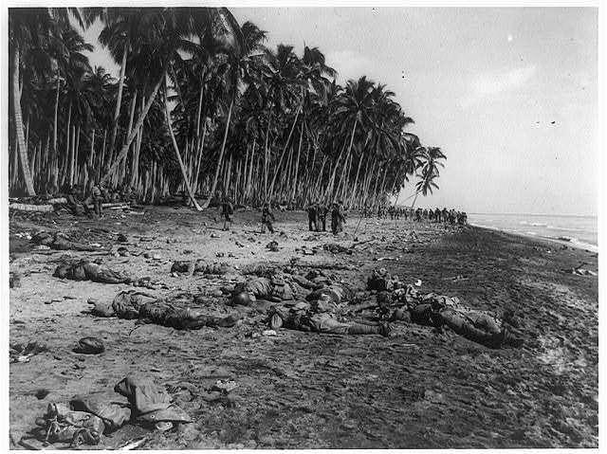
Guadalcanal
To get the upperhand in their war against the Japanese in the pacific, America had this technique known as island hopping. Their were a series of islands in the pacific between America and Japan, one of those islands was Guadalcanal. Guadalcanal was located at the southwest Pacific in the Solo Islands, east of New Guinea. In 1942, General Douglas MacArthur and his troops started a campaign first invading Guadalcanal. This invasion was successful and it was the first defeat of Japan on land. This lead MacArthur to capture more islands surrounding the Japanese base in the region causing them to withdrew with their ships and aircraft and leaving many troops behind.
Notes:
Image obtained from Google Images and is licensed for reuse.
Tucker, Ryan. Lecture given at Clovis High School. February 2024.
United States History & Geography Community & Change
Dead Japanese soldiers strewn over a beach on Guadalcanal, Solomon Islands, while U.S. Marines get the lay of the land and consolidate their positions (Public Domain), Picryl

Slide 10
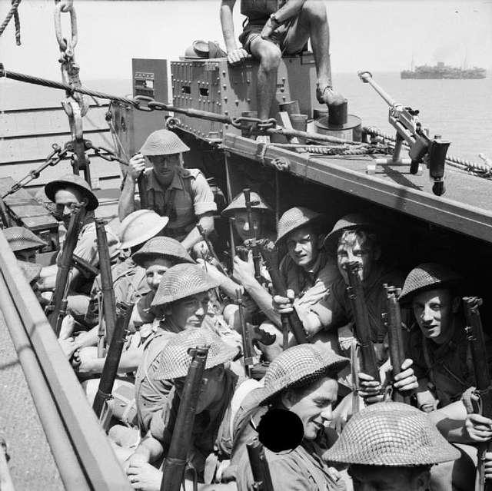
Invasion of Sicily
In 1943, the Allies wanted to end the Axis Powers. One of their plans was to invade the homeland of the Italians, Sicily. They expect that if this invasion was successful, the Italians would quit the war and stop being apart of the Axis. General Dwight D. Eisenhower commanded the invasion with General Patton and Bernard Montgomery, they quickly go captured a good amount of the island. This lead to Benito Mussolini, Italy’s fascist dictator to be arrest by the king of Italy and Italian generals, they saw him as the person that got Italy into to this and they had enough. After Mussolini’s arrest, Italy negotiate a surrender to the Allies.
Notes:
Image obtained from Google Images and is licensed for reuse.
Tucker, Ryan. Lecture given at Clovis High School. February 2024.
United States History & Geography Community & Change
The Invasion of Sicily 1943 NA4502 (Public Domain), Picryl

Slide 11
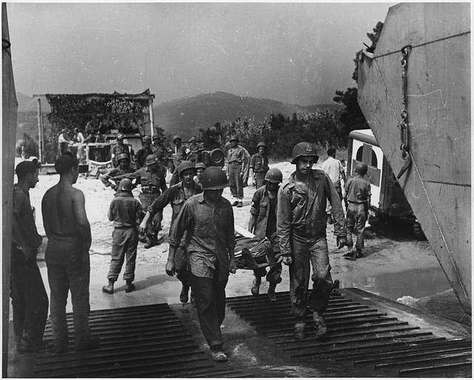
D-Day, Operation Overlord
The Allies were winning to take Europe in WW2, there one last obstacle was Hitler and the German nazis. The Allies thought the best idea to do was to force Germany in a two front war, where the Soviets attack Germany and America and Great Britain invaded the France as it was captured by Germany and losing it would be a great lose for the Germans. General Eisenhower was selected to lead the invasion in 1944 and hundreds of thousands of American, Canadian, and British troops started their attack in northern France. This invasion was successful as in a few months the Allies Allies freed France, Belgium, and Luxembourg. This large land-sea-air invasion was a major victory for the Allies.
Notes:
Image obtained from Google Images and is licensed for reuse.
Tucker, Ryan. Lecture given at Clovis High School. February 2024.
United States History & Geography Community & Change
WWII, Europe, France, Invasion, "American Wounded" - NARA - 195328 (Public Domain), Picryl

Slide 12
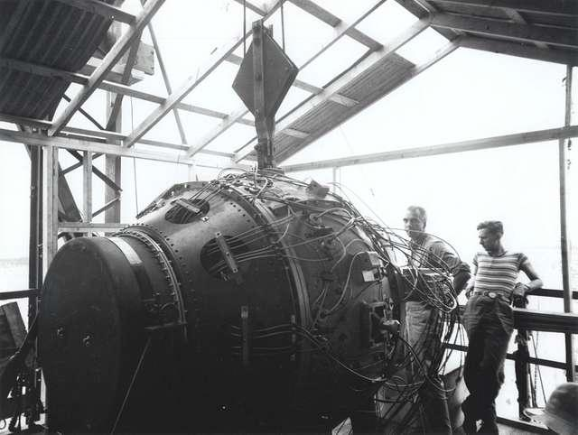
Trinity Test
In 1945, the Trinity Test happened. A nuclear bomb successfully exploded in Alamogordo, New Mexico. America had been working on bombs in fear that their enemies would create bombs against them. A team led by J. Robert Oppenheimer, had created the nuclear bombs. After this success, more bombs were create to use in the war. Oppenheimer wanted to delay the use of the bombs. Many individuals debated how to use the bomb especially against the Japanese in their home nation.
Notes:
Image obtained from Google Images and is licensed for reuse.
Tucker, Ryan. Lecture given at Clovis High School. February 2024.
United States History & Geography Community & Change
The gadget in the Trinity Test Site tower (1945) (Public Domain), Picryl

Slide 13
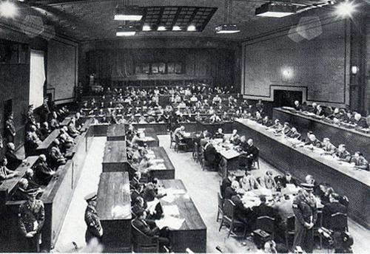
Nuremberg Trials
After the end of World War 2 in 1945, the Axis Powers had to deal with their consequences of their actions in the war. The U.S., Britain, France, and the Soviet Union created the International Military Tribunal putting Nazi leaders on trial. These were the Nuremberg Trials, Hitler died before his punishment can be enforce, his many remaining Nazi followers leaders were tried. There were a few individuals that were acquitted, many were imprisoned, and some were sentenced to death. These trials made a standard of what to do in a war and what not to do.
Notes:
Image obtained from Google Images and is licensed for reuse.
Tucker, Ryan. Lecture given at Clovis High School. February 2024.
United States History & Geography Community & Change
IMTFE court chamber. Public domain, Post-war Japan. (Public Domain), Picryl

